Slide 1

NUTRITION: Percent Fat PPT http://www.youtube.com/watch?v=-ZzBUbwxfL0&safety_mode=true&persist_safety_mode=1

Slide 2

McDonald’s Menu Activity
Food Calories Total fat (g)
1. Hamburger
2. Med. Fry
3. Large Coke
4. 3 Ketchup Pkts
Totals:

Slide 3
AVERAGES
TEEN GIRLS TEEN BOYS
Avg. calories 2000 2800
Avg. total fat (g) 73 93
Problem:
Trish is a 16-year old female that is 5’4” and weighs 105 pounds. She gets less than 30 minutes of physical activity per day and wants to know approximately how many calories she should consume?
A. 1000-1200 C. 1800-2000
B. 3200-3400 D. 4500-4700

Slide 4
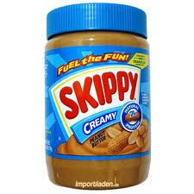
Figuring Out Food’s
% of calories from FAT
(9X/Y)100
X= Total Fat Grams per serving
(You multiply by 9 since there are 9 calories per gram of fat.)
Y= Total calories per serving
Multiply above answer by 100 = % Fat
Skippy Peanut Butter
16 grams of fat, 190 calories per serving
(9X16/190)100=
(144/190)100=
(.7578)100=
=75%

Slide 5
FAT INTAKE
USDA (United States Department of Agriculture) recommends daily percent fat intake to be anywhere from 20-35% (no more than 35).
~10% Saturated (animal fats)
~20-25% unsaturated (fats from vegetables)
                A high intake of fat (greater than 35 percent of calories) generally increases saturated fat intake and makes it more difficult to avoid consuming excess calories. A low intake of fats and oils (less than 20 percent of calories) increases the risk of inadequate intakes of vitamin E and of essential fatty acids and may contribute to unfavorable changes in high-density lipoprotein (HDL) blood cholesterol and triglycerides.

Slide 6
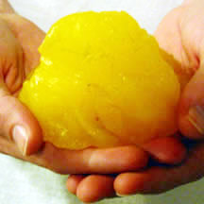
MATCH THE ANSWER
How many calories are there in one pound of fat?
How many calories are there per gram of fat?
How many calories per gram of Protein?
How many calories per gram of Carbohydrates?
ANSWERS: A. 4 B. 3,500 C. 9 D. 4

Slide 7
1) B: 3,500
2) C: 9
3) A or D : 4
4) A or D: 4

